Slide 1

Evaluating Strict Liability under POCSO in light of social realities
Swagata Raha, Director-Research & Co-Director, Restorative Practices
13 August 2026

Slide 2
“...justification put forth by the Ministry was that emerging social reality regarding awareness, understanding and exposure of the adolescents cannot be overlooked and it would cause more detriment to criminalize consensual action by children between 16 to 18 years of age.”
Department-related Parliamentary Standing Committee on Human Resource Development, 240th Report on the POCSO Bill, 2011, Para 6.7
“In all of us, agency and vulnerability coexist.” Prajwala
v. Union of India, 2026 INSC 609

Slide 3

Adolescence is universally recognised as a “unique defining stage of human development”, marking a transition between childhood and adulthood and “characterized by rapid brain development and physical growth, enhanced cognitive ability, the onset of puberty and sexual awareness and newly emerging abilities, strengths and skills.” (CRC, General Comment No. 20 on the implementation of the rights of the child during adolescence (2016), para 9)
“Sexual exploration, is also a part of their developmental journey of understanding boundaries, and their identity.” Enfold Proactive Health Trust & NCAAC, Balancing Protection and Autonomy: Rethinking the Criminalisation of Adolescent Sexuality (2025) 24.
Notes:
Teenage sexual behaviour is not deviant but a standard behavioural characteristic of adolescence. Research recommends a positive response
framework to this developmental dimension, that entails supporting young people
in recognising unhealthy influences around sexuality, understanding autonomy and
consent, and destigmatising curiosity about sex and romantic relationships.

Slide 4
Central Argument
The POCSO Act, through blanket criminalisation of all sexual acts with persons below 18 years, fails to account for the normative nature of adolescent sexuality, which renders the classification it makes unreasonable, its provisions arbitrary and disproportionate, and the criminalisation violative of fundamental rights under Articles 14 and 21 of the Constitution.

Slide 5
Criminalisation of Adolescent Consensual Sex Violates Right to Equality
The POCSO Act in operation has a discriminatory impact on
Girls whose family oppose her relationship
Girls seeking sexual and reproductive health services
Boys where the couple is below 18
Tribal communities that accept adolescent sexuality
There is no rational nexus between the blanket criminalisation of adolescent sexuality and the objective of POCSO to protect children from sexual assault, harassment and pornography
Treating all persons under 18 years of age as a single category, without consideration of specific needs and traits of adolescents is arbitrary, irrational and fails reasonable classification.
Notes:
The asymmetrical application of POCSO Act,
branding males as “rapists”, and girls as passive victims also promotes
harmful and stigmatising stereotypes. Thus, the needs and traits of older children in the area of sexuality and sexual
exploration are distinct from both younger children and from adults.

Slide 6
Criminalisation of Normative Behaviour Violates Right to Life, Liberty and Dignity under Article 21
Non-recognition of normative nature of adolescent sexuality offends dignity
Dignity = (i) the right not to be treated as an object, (ii) access to the minimum material conditions for a meaningful life, and (iii) the right to be recognised. Prajwala v. Union of India, 2026 INSC 609
“ A strict textual approach to the law, when deployed in cases such as the present one, in effect, prioritises a protective, statute- based understanding of harm over lived reality, thereby collapsing the distinction between actual victimhood and presumed vulnerability. The result is a peculiar scenario where the victim neither claims nor experiences harm, yet the legal framework insists on her victimhood, and the offender-status of the accused.” Harmeet Singh v State Government of GNCT, W.P.(CRL) 1985/2025 (decided on 16.04.26 by Delhi High Court).
Notes:
(wa) “victim” means a person who has suffered any loss or injury caused by reason of the act or omission for which the
accused person has been charged and the expression “victim” includes his or her guardian or legal heir; FUTILE + ABSURD = enormous consequences
Supporting adolescents requires
equipping them to understanding autonomy and consent, and
destigmatising sex and romantic relationships.

Slide 7









Impact of
Criminalisation
Undermines dignity & privacy
Overburdens
Justice System
Undermines
Best Interests & Evolving Autonomy
Deprivation of Liberty
Barrier to Sexual &
Reproductive Health
Notes:
Equating normative consensual acts with sexual offending results in criminal investigation and trial, medical examinations, and punishment, which have a stigmatic and disruptive impact on the education, employment, family life, and social reputation.
Institutionalises shame and control of girls, reinforces regressive notions around sexuality.

Slide 8
Criminalisation of adolescent sexuality impedes adolescents’ right to sexual and reproductive health
Criminalisation of consensual acts + Mandatory Reporting adversely affects:
Criminalisation of consensual sex reinforces stigma around sex and impedes access to safe and barrier-free sexual and reproductive health care and education
Adolescents’ access to contraception, abortion, pregnancy care, mental health services, diagnostics for STIs
Doctor-patient confidentiality leading to unsafe abortions
Government health programs like Rashtriya Kishore Swasthya Karyakram
Notes:
HOSPITALS AS SURVEILLANCE SITE, Guards appointed so that they don’t escape, pregnant girls/just given birth - husband arrested, information access affected

Slide 9
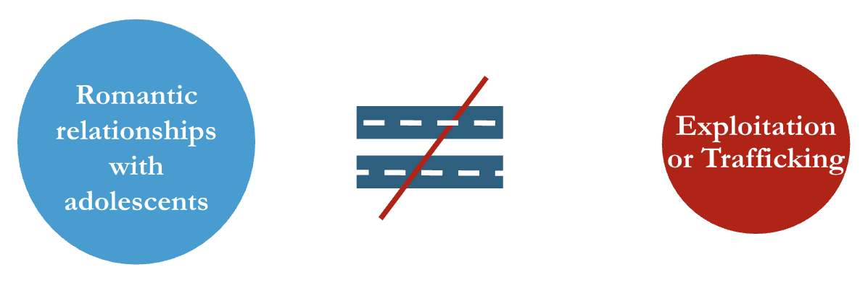
Blanket Criminalisation is a Grossly Disproportionate Response
Teen pregnancies and health risks can be addressed through health and education measures that are less restrictive.
The State’s
obligation under Article 14 and 21 is to adopt those means that protect
adolescents’ well-being with minimal intrusion into their liberty, privacy, and dignity.
Notes:
Criminal action is a disproportionate response merely on the suspicion that some sexual acts may be exploitative, have harmful health consequences, or are socially undesirable.
Inappropriateness of conduct cannot justify its criminalisation.
Simple expressions of love and connection, such as holding hands and kissing, are criminalised
Teen pregnancies and health risks can be addressed through health and education measures that are less restrictive.
In any case, the POCSO Act does not prevent or deter teenage pregnancies or promote adolescent health. Teenage pregnancies and health risks associated with early pregnancy can be effectively addressed through health and educational measures such as comprehensive sexuality education, timely access to reproductive health services, accessible contraception, and adequate
nutrition, irrespective of the girls’ age and marital status.
Viewing all relationships solely from the lens of inherent or potential exploitation undermines evolving autonomy, infantilises adolescents, and places them at greater risk of marginalisation for expressions
of love and connection.

Slide 10
Why Romeo-Juliet Clauses are not the answer
Investigation and trial still follow and adolescents are not spared humiliation and trauma of criminal processes.
Cases will drag on until courts or JJBs confirm the age gap and consent.
Proving age is hard — longer trials, longer detention for both.
Age gap is only one factor; many factors can vitiate consent.
"Romeo and Juliet" laws allow a 1–5 year gap, but this is where the age of consent is already 14–16, far below India's.

Slide 11
What is proposed?
Those under 18 years (of all genders) should continue to be protected under the POCSO Act when they are victims of non-consensual sexual acts.
  Compensation
  Child-friendly proceedings
  Special Courts
Exceptional circumstances where consent of those above 16 will be vitiated - grounds under Section 63, BNS and:
  Sex with an adult in a position of trust or authority
  Sex in the context of hiring, employing or using the child for sexual exploitation or child abuse material
Presumption as to absence of consent in cases of aggravated rape under Section 120 BSA will apply.
Emphasis on Supportive Measures
  Comprehensive Sexuality Education
  Strengthening child protection systems
  Barrier free access to SRHR

